Slide 1
Car Price Prediction Model

Slide 2
Project objective and motivation
Consumer Empowerment: Empowering consumers with accurate and detailed information to make informed decisions.
Market Analysis: Providing automotive businesses and professionals with insights into market trends, consumer preferences, and competitive analysis.
Technological Advancement: Utilizing data science and machine learning techniques to analyze and present data in innovative ways.
Educational Value: Offering a resource for automotive enthusiasts and students to learn more about car specifications and industry trends.
Environmental Considerations: Highlighting fuel efficiency and eco-friendly options to promote sustainable transportation choices.

Slide 3

Car Details Project Features Name: The make and model of the car. Year: The year the car was manufactured. KM Driven: The total kilometers the car has been driven. Fuel: The type of fuel the car uses (e.g., Petrol, Diesel, Electric, Hybrid). Seller Type: The type of seller (e.g., Individual, Dealer). Transmission: The type of transmission in the car (e.g., Manual, Automatic). Owner: The number of previous owners of the car. Car Details Project Target Selling Price: to Predict selling price of the car.

Slide 4

Steps Involved in Processing Car Details Project
Imported Libraries
Data Preprocessing
Feature Engineering
Exploratory Data Analysis (EDA)
Select features and labels
Import Machine Learning Models
Evaluate Different Models
Save the Model
Visualizations
Deployment

Slide 5
Exploratory Data Analysis (EDA)
Visualizing the distribution of numerical features using histogram
Examining correlations between numerical features.
Visualizing relationships between numerical features using pair plots.
Analyzing the relationship between categorical and numerical features using box plots.

Slide 6
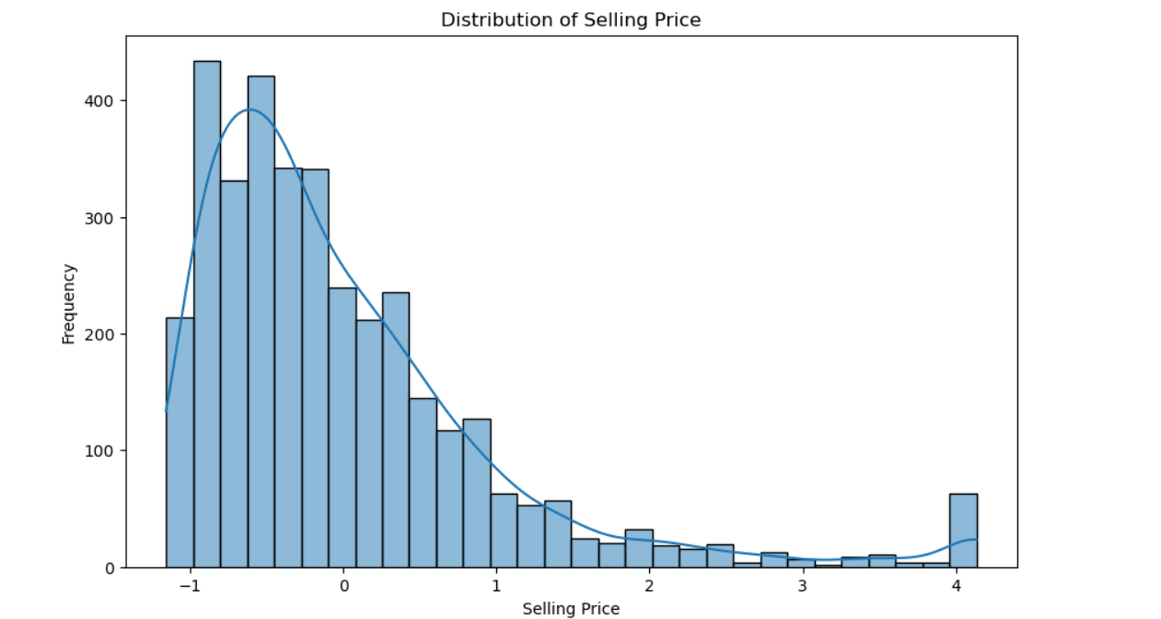
Frequency distribution of selling Price

Slide 7
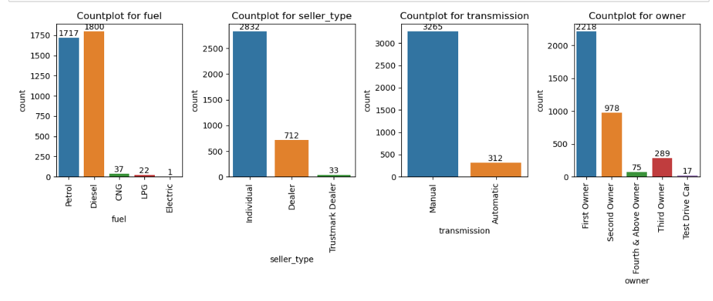
Counts for each features

Slide 8
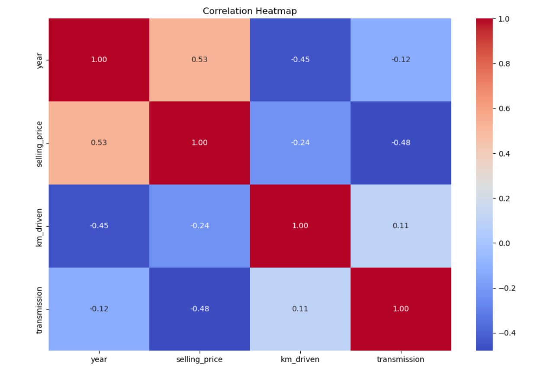
Correlation between each features and label

Slide 9
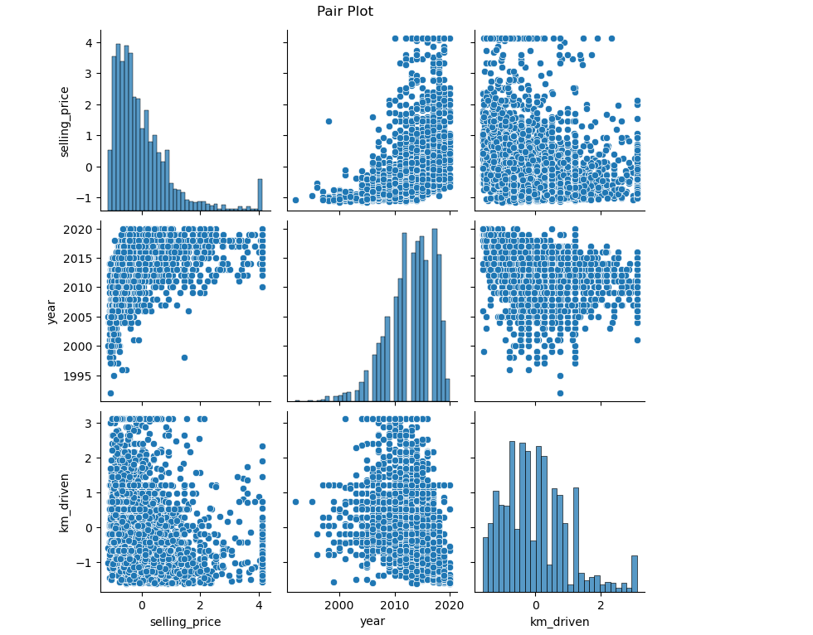
Relation between each feature and labels

Slide 10
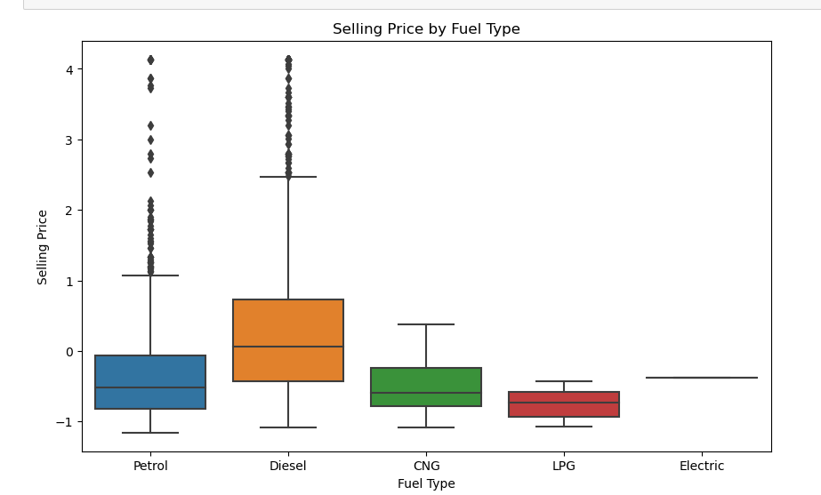
Selling Price with respect of Fuel type

Slide 11
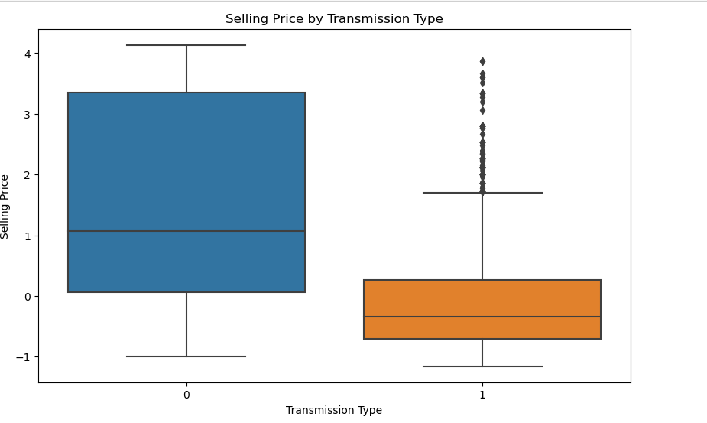
Selling Price with respect of transmission type

Slide 12
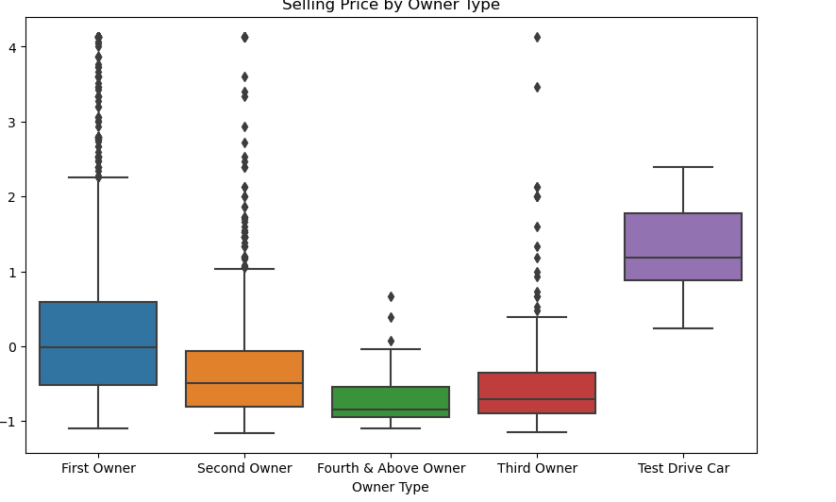
Selling Price with respect of Owner type

Slide 13
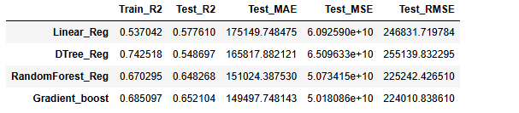
Model Performance

Slide 14

Key Insights
1. Data Preprocessing
2. Exploratory Data Analysis (EDA)
3. Model Building and Evaluation
4. Best Model
5. Feature Importance

Slide 15

Future Scope
Hyperparameter Tuning: Perform extensive hyperparameter tuning using techniques like Grid Search or Random Search to find the optimal parameters for the models.
Advanced Models: Experiment with more advanced models such as XGBoost, LightGBM, or deep learning models to potentially improve prediction accuracy.
Stacking and Blending: Implement ensemble methods like stacking and blending to combine multiple models and enhance overall performance.

Slide 16
Dynamic delivery
Learn to infuse energy into your delivery to leave a lasting impression
One of the goals of effective communication is to motivate your audience
Metric | Measurement | Target | Actual
Audience attendance | # of attendees | 150 | 120
Engagement duration | Minutes | 60 | 75
Q&A interaction | # of questions | 10 | 15
Positive feedback | Percentage (%) | 90 | 95
Rate of information retention | Percentage (%) | 80 | 85

Slide 17
1. Data Preprocessing
Null Values: There were no null values in the dataset, which simplified the preprocessing step.
Duplicates: Some duplicate rows were found and removed to ensure data integrity.
Inconsistent Data: Outliers in km_driven and selling_price were capped to 200,000 and 2,000,000 respectively to handle extreme values.
Data Types: Necessary data type conversions were performed to ensure proper handling of categorical and numerical features.
Categorical Encoding: Categorical variables such as fuel, seller_type, and owner were encoded using one-hot encoding.

Slide 18
2. Exploratory Data Analysis (EDA)
Categorical Features: Most cars are manual, and petrol is the most common fuel type. Individual sellers dominate the market, with first owners being the most common owner type.
Numerical Features: Distribution of selling_price and km_driven were analyzed using histograms and boxplots. Outliers were found and treated appropriately.
Correlation Analysis: Correlation heatmap revealed that year and km_driven have a noticeable correlation with selling_price, indicating their importance in predicting car prices.

Slide 19
3. Model Building and Evaluation
Multiple machine learning models were built and evaluated to predict car prices. The performance of each model was assessed using metrics such as R^2 score, Mean Absolute Error (MAE), Mean Squared Error (MSE), and Root Mean Squared Error (RMSE).

Slide 20
4. Best Model
The Gradient Boosting Regressor emerged as the best model for predicting car prices based on its performance metrics:
Train R^2: 0.701
Test R^2: 0.689
Test MAE: 0.405
Test MSE: 0.318
Test RMSE: 0.564

Slide 21
5. Feature Importance
The importance of features in the best model (Gradient Boosting Regressor) indicates which factors most significantly influence car prices. The most important features were:
Year: Newer cars tend to have higher selling prices.
KM Driven: Cars with lower mileage tend to have higher selling prices.
Transmission: Manual or automatic transmission affects the price.
Fuel Type: Different fuel types have varying impacts on car prices.
Owner Type: The number of previous owners influences the car's selling price.

Slide 22
Speaking engagement metrics
Impact factor | Measurement | Target | Achieved
Audience interaction | Percentage (%) | 85 | 88
Knowledge retention | Percentage (%) | 75 | 80
Post-presentation surveys | Average rating | 4.2 | 4.5
Referral rate | Percentage (%) | 10 | 12
Collaboration opportunities | # of opportunities | 8 | 10

Slide 23
Thank you
Brita Tamm
502-555-0152
brita@firstupconsultants.com
www.firstupconsultants.com

